Slide 1
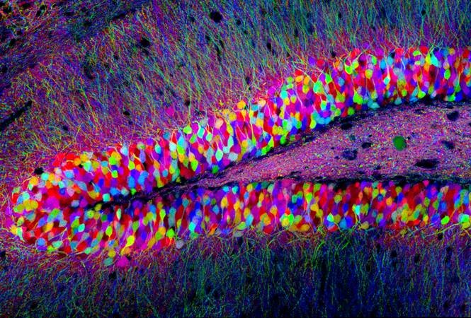
Track Module 1: Basics of Image Processing and ML in Python
Ekaterina Golubeva
03.10.2022

Slide 2
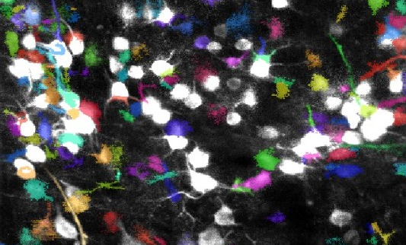
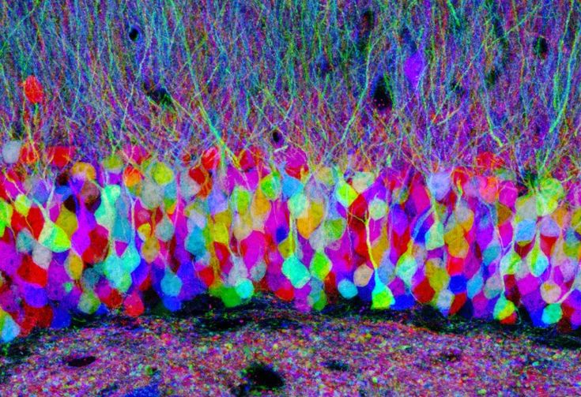
Block 1-2
Videos Block 1:
04. What is a digital image?
16 - Understanding digital images for Python processing
17- Reading images in Python
Videos Block 2:
18- Image processing using pillow in Python
19- Image processing using scipy in Python

Slide 3
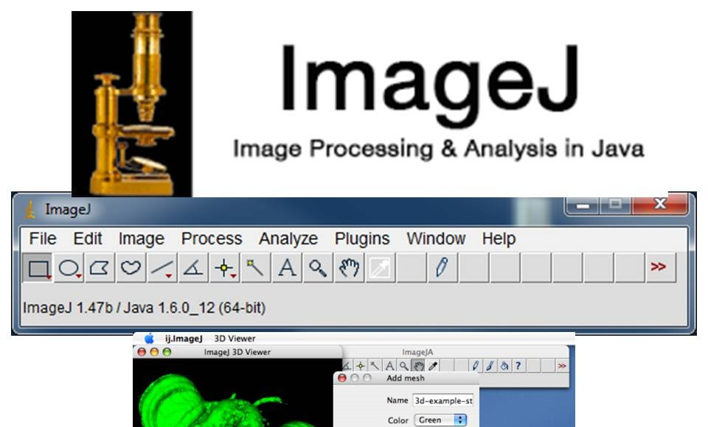

Why do we need to learn programming?
Programming is important for life sciences because data is everywhere and under different forms (images, data, text). Programming helps extract information from this data. Software like ImageJ can help us to do the image processing. However, in order to treat big number of images or treat them many times, it’s much easier to create a code that does it and automate the task for us in stead of doing it manually.

Slide 4
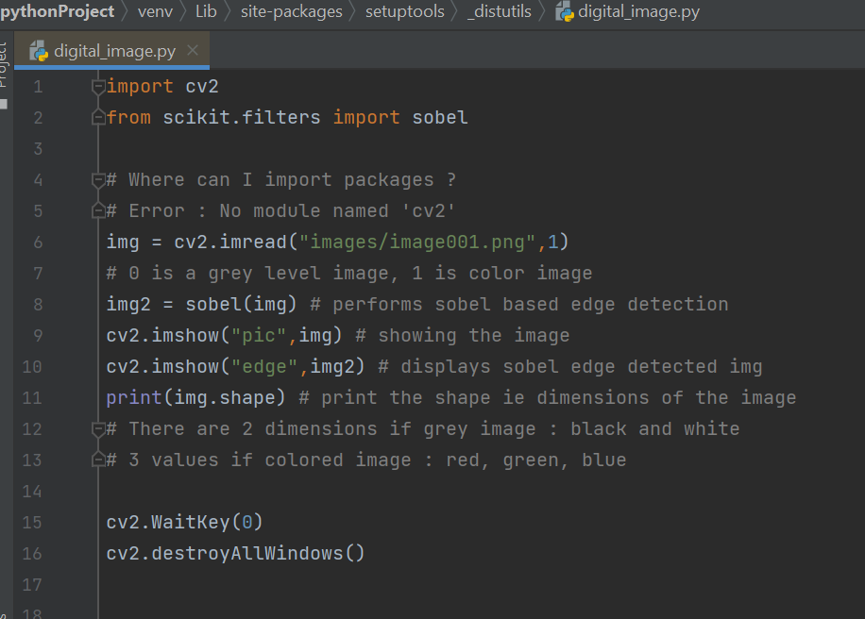
What is a digital image ?
It’s a collection of numbers in a matrix form. A digital image and each number means and intensity the intensity of that specific pixel.

Slide 5
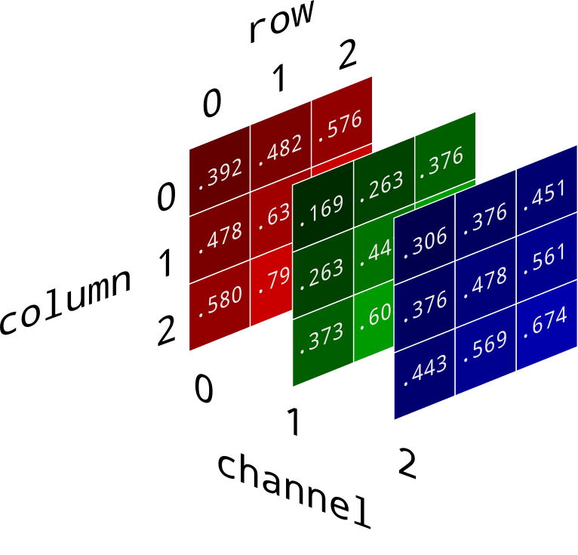
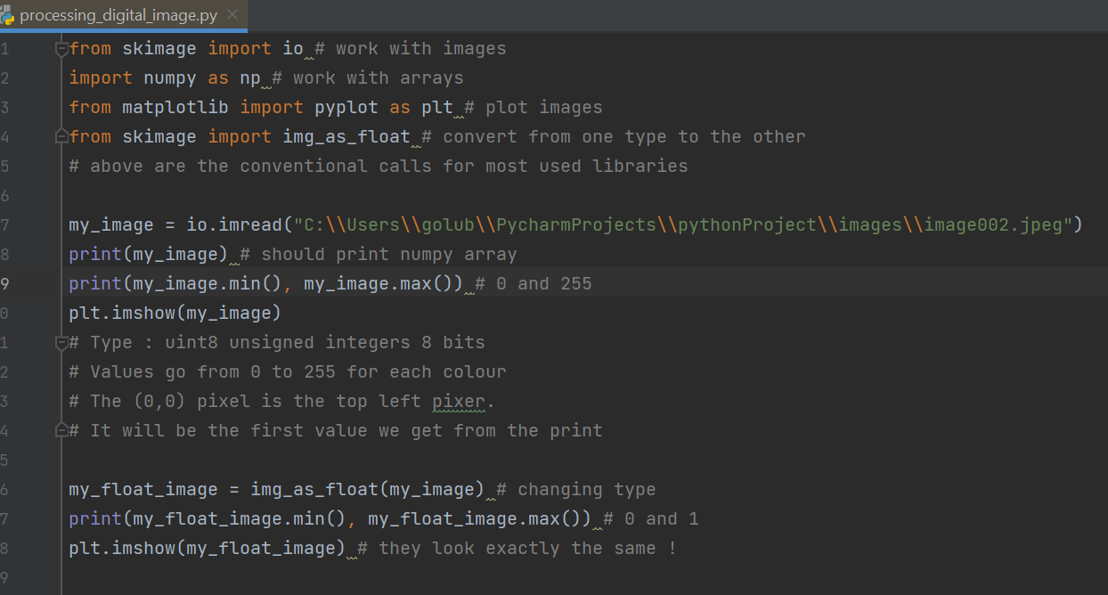
Understanding digital images for Python processing

Slide 6
Reading images in Python
Mainly 4 libraries :
Pillow PIL
Mat plot lib
Scikit image
OpenCV

Slide 7
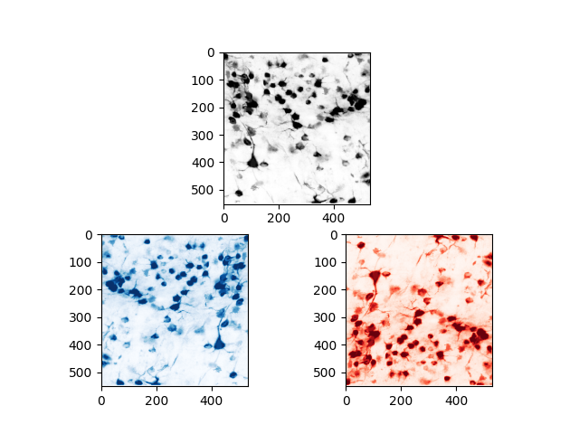
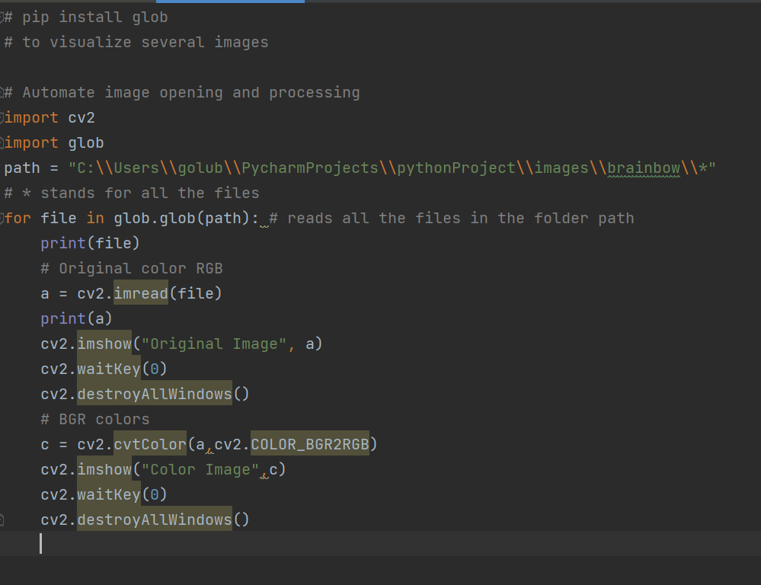
Automate reading of multiple images

Slide 8
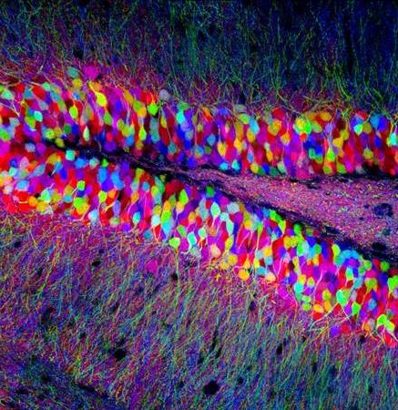
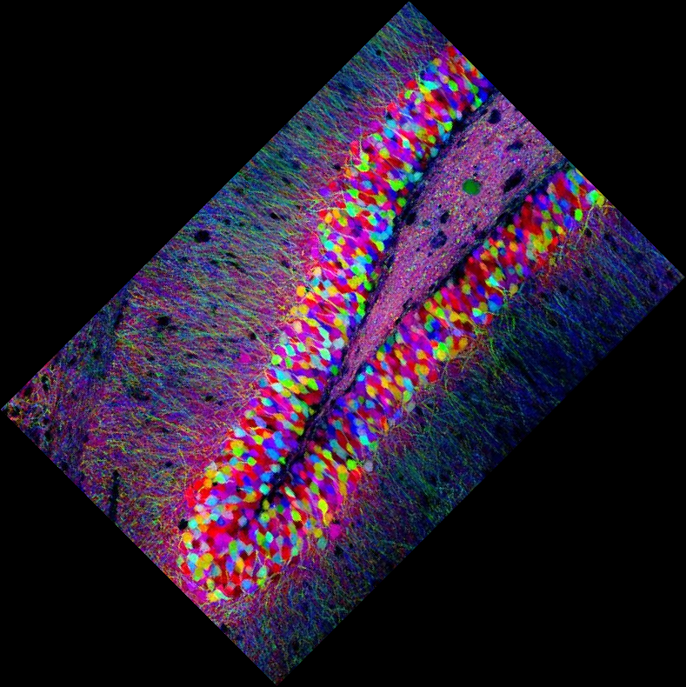
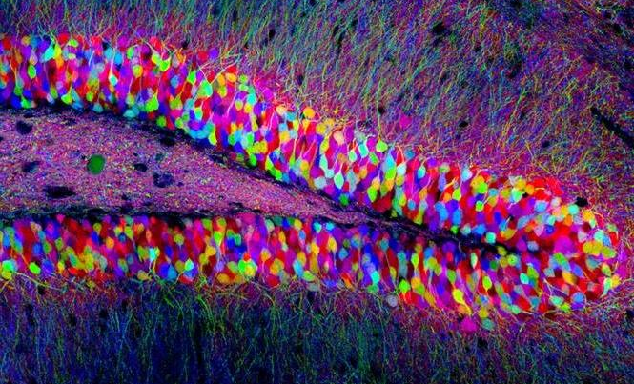
Image processing using pillow in Python
Cropping
Transposing L-R,T-B
Rotating
Basic geometric transformations

Slide 9
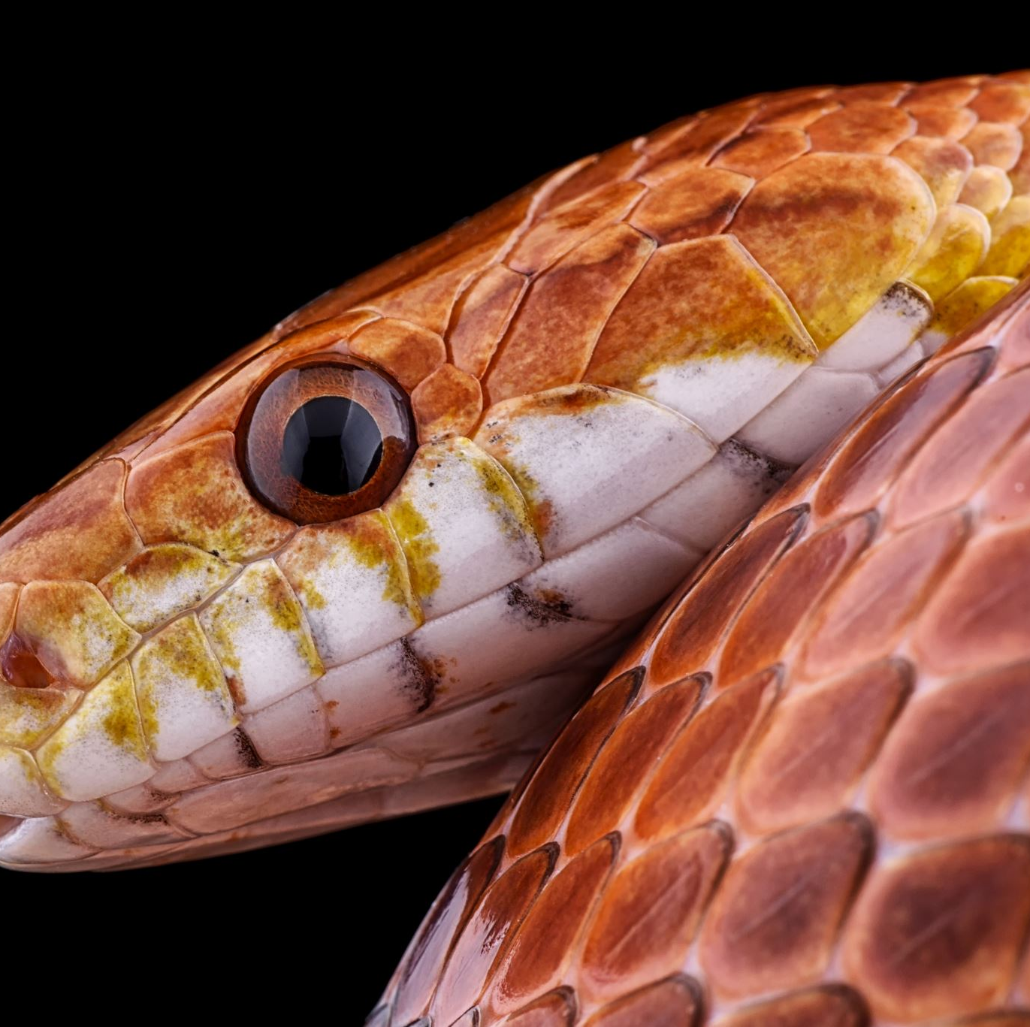
Image processing using scipy in Python
It’s a library which is part of the numpy stock. It contains modules for linear algebra, signal processing, image processing

Slide 10
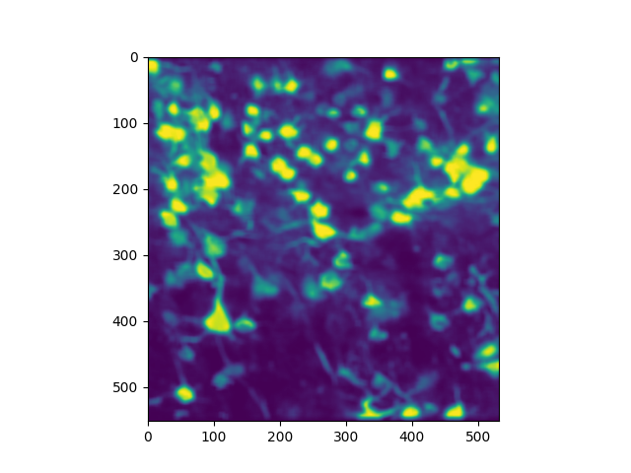
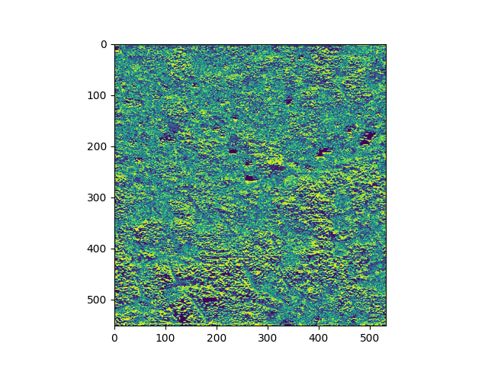
Filters
Gaussian
Uniform
Median
Sobel

Slide 11
List of commands used
Command | Description | Library/Package
import cv2 | Import OpenCV | OpenCV
cv2.imread | Read an image | OpenCV
sobel(img) | Performs sobel based edge detection | OpenCV
cv2.imshow("name",img) | Shows the image with a chosen name | OpenCV
print(img.shape) | Prints the shape ie dimensions of the image | OpenCV
cv2.WaitKey(0) cv2.destroyAllWindows() | Closes windows 0 -manually N – after N milliseconds | OpenCV
plt.imshow(cv2.cvtColor(img,cv2.COLOR_BGR2RGB)) | Changes the color space | OpenCV
io.imread(img path, as_gray = True/False) | Reads the file | Skimage, io
img_as_ubyte() | Changes the type of image to ubyte | Skimage
plt.show()/plt.imshow(img, cmap= "Greys") | Plots the figure above Cmap is a colormap | matplotlib.pyplot
plt.subplot(2,1,1) | Create a subplot in a big panel of multiple plots | Matplotlib, pyplot
mpimg.imread() |  | matplotlib.image
img_as_float() | Changes the type of image to float | Skimage, img_as_float
np.random.random([n,m]) | Creates random image with dimensions nxm | numpy
np.flipud(img) | Flips upside down | numpy
Np.fliplr(img) | Flips from left to right | numpy
Image.open() | Reads the image | Pillow
np.asarray() | Saves the image in np arra type (not jpg) | Pillow
glob.glob(path) | Reads all the files in the folder path | glob
img.resize((n,m)) | Resizes image (without preserving aspect ratio) | Pillow
img.thumbnail((n,m)) | Resizes the image preserving the aspect ratio | Pillow
img.save() | Save the image at the indicated path | Pillow
img.crop() | Crops image, indicate coordinates | Pillow
img.rotate(degrees, expand = True) | Rotates the image by degrees and fits the image so the edges are preserved | Pillow
imgh.convert("L") | convert to grey level | Pillow
img.transpose(Image.Transpose.FLIP_LEFT_RIGHT) | Flips the image from left to right | Pillow
imgh.transpose(Image.Transpose.FLIP_TOP_BOTTOM) | Flips the image from top to bottom | Pillow
ndimage.uniform_filter(img, size =n) | Uniform filter | Scipy/skimage
ndimage.gaussian_filter(img, sigma =n) | Gaussian filter | Scipy/skimage
ndimage.median_filter(img, size =n) | Median filter | Scipy/skimage
ndimage.sobel(img, axis =0) | Sobel filter | Scipy/skimage

Slide 12
Further documentation
Filters in Scipy https://docs.scipy.org/doc/scipy/reference/ndimage.html?highlight=filter#
Colormaps in Matplotlib
https://matplotlib.org/stable/tutorials/colors/colormaps.html

Slide 13

Goals for next time
More specifically, what is the entropy filter? Apply to an example image.
What is thresholding? Try for an example image.
Study Gaussian, uniform, median, sobel filters
Edge and shape detection in Python
Optional videos:
02: What is programming ?
03: What is command prompt?
20- Introduction to image processing using scikit-image in Python

